Slide 1
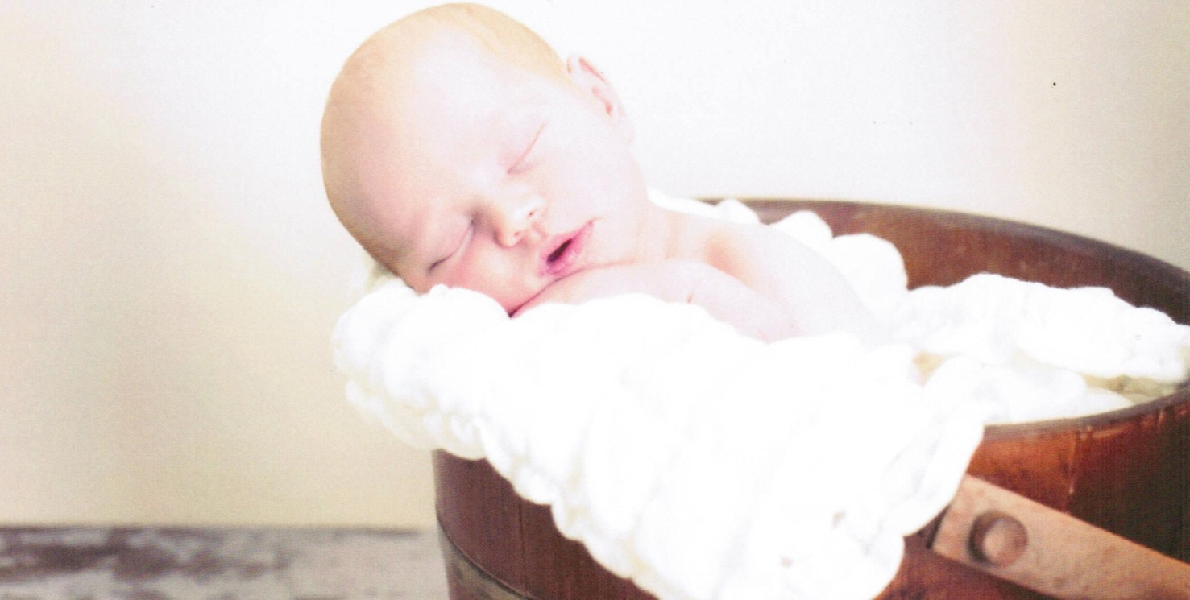
NaProTECHNOLOGY in Catholic Healthcare
Theresa Stigen, MD
FertilityCare Medical Consultant
Fellowship-trained NaProTECHNOLOGY Surgeon

Slide 2
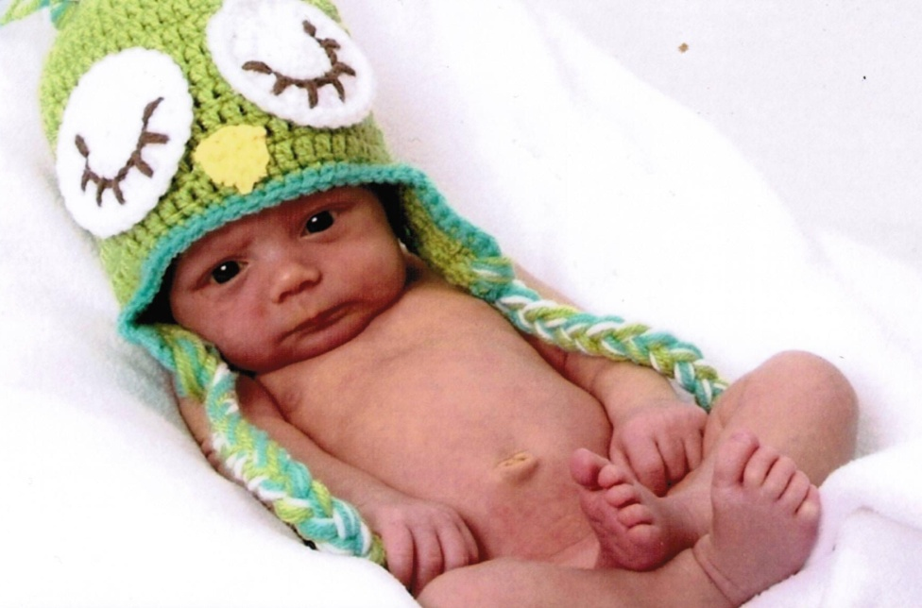
What is NaProTECHNOLOGY?
Natural Procreative TECHNOLOGY
  A major breakthrough in monitoring and maintaining a woman's reproductive and gynecological health
  Uses the information contained in the Creighton Model FertilityCare System charting and applies 30 years of scientific research in the study of the normal and abnormal states of the menstrual and fertility cycles to unravel their mysteries
  It provides medical and surgical treatments that cooperate completely with the reproductive system

Slide 3
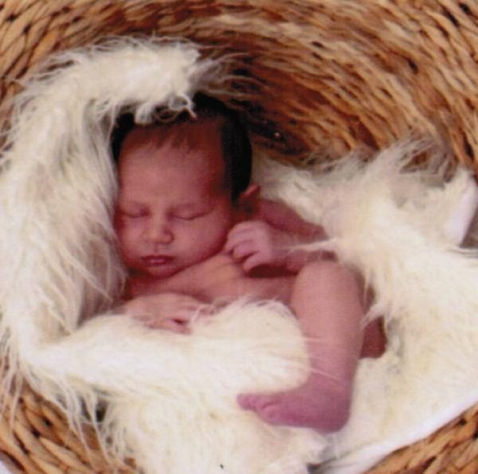
Applications of NaProTECHNOLOGY
True Family Planning
Infertility
Recurrent miscarriage
Preterm Labor
Postpartum depression
Premenstrual Syndrome
Heavy periods
Painful periods
Irregular periods
Endometriosis
Ovarian cysts
Polycystic Ovarian Syndrome (PCOS)

Slide 4
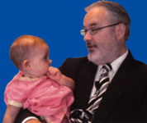
Does Catholic Healthcare Need NaProTECHNOLOGY?
If Catholic healthcare needs:
  Effective treatments for all of a woman’s gynecologic health needs
  Cutting edge, in-demand technology
  Pro-Woman
  Pro-Life
  YES!!!

Slide 5

NaProTECHNOLOGY
Pro-Life Women’s Health Care

Slide 6

The Answer to the Question
Family Planning Contraception
Natural Family Planning
A Pro-Life Issue?
  Contraception is linked to abortion both directly and indirectly

Slide 7
The Abortion-Contraception Connection:
The Direct Link
All hormonal methods of contraception have abortifacient effects as one, if not their sole, mechanism of preventing pregnancy
Breakthrough ovulations occur in anywhere from 4-81% of cycles
  Pregnancy rate in women of normal fertility is about 20% per cycle
  0.8-16.2% of breakthrough ovulations would be expected to result in conception

Slide 8

The Abortion-Contraception Connection:
The Indirect Link
Judicial Evidence
  Planned Parenthood v. Casey, 1992 –
  "in some critical respects abortion is of the same character as the decision to use contraception . . . . for two decades of economic and social developments, people have organized intimate relationships and made choices that define their views of themselves and their places in society, in reliance on the availability of abortion in the event that contraception should fail."

Slide 9

The Abortion-Contraception Connection:
The Indirect Link
Medical Evidence
  Study from Spain published in the Jan 2011 issue of the medical journal Contraception
    1997-2007 – Number of women using contraceptives increased from 49.1% to 79.9%
    1997-2007 – Abortion rate more than doubled from 5.52 abortions per1000 women to 11.49

Slide 10
The Abortion-Contraception Connection:
The Indirect Link
Moral Evidence
  “Contraception facilitates the kind of relationships and even the kind of attitudes and moral characters that are likely to lead to abortion.” – Janet Smith
    Babies are a “mistake” of sexual intercourse, not the natural result
    No accident that the “sexual revolution” began on the heels of the birth control pill becoming available (1960)

Slide 11

The Abortion-Contraception Connection:
The Indirect Link
The Prophetic Evidence
  Predictions made by Pope Paul VI in Humanae Vitae regarding the consequences of contraception
    “…the danger of this power [contraception] passing into the hands of those public authorities who…should they regard this as necessary, they may even impose their use on everyone.”
      United Nations requires third world countries who accept economic aid to also accept aggressive distribution of contraception

Slide 12

The Abortion-Contraception Connection
The evidence is clear that contraceptive practices go hand in hand with abortion
It is impossible to be pro-life and support contraception!

Slide 13
The Answer to the Question
Women’s Health Problems
Heavy periods The Pill
Painful periods The Pill
Irregular periods The Pill
Endometriosis The Pill
Ovarian cysts The Pill
PCOS The Pill
PMS The Pill
NaProTECHNOLOGY provides effective, pro-life alternatives to The Pill for all health problems a woman may encounter

Slide 14
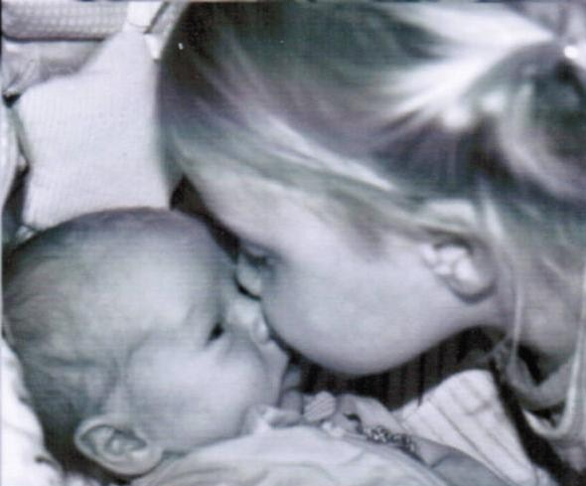
The Answer to the Question
Reproductive Health Problems
Infertility IVF
Recurrent miscarriage IVF
NaProTECHNOLOGY provides effective and cooperative treatments for infertility and miscarriage that are pro-life and respectful of a couple’s intimacy
A Pro-Life Issue?
IVF and other ART treatments are linked directly and indirectly to abortion

Slide 15
The Abortion-IVF Connection
IVF is founded on the concept of destroying life in order to create it
  For every successful IVF pregnancy, ~6 babies are wasted in the attempt
  Abortion is strongly encouraged for any multiples pregnancy greater than twins (“Selective Reduction”)
  Couples are encouraged to discard or abort “poor quality” babies
  Preimplantation Genetics Diagnosis further encourages discarding babies who are “undesirable” and allows for gender selection bias

Slide 16
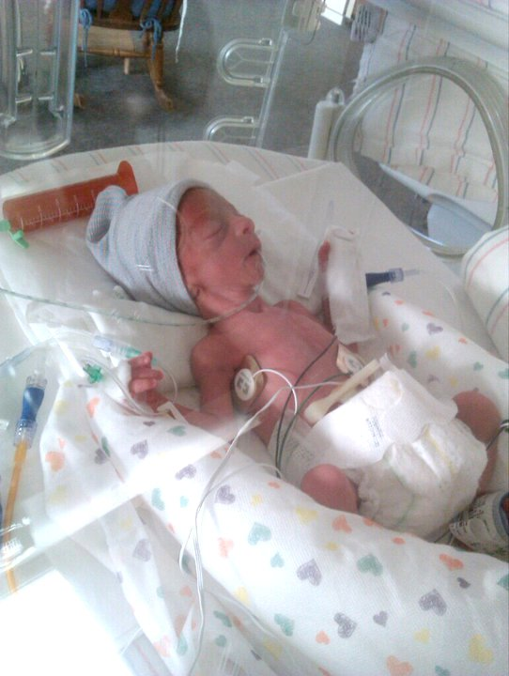
The Answer to the Question
Pregnancy Related Problems
Preterm Labor Complacency
  Preterm Labor rate can be reduced with NaProTECHNOLOGY from ~12% to 7%
  A HUGE Pro-Life Issue!
Postpartum depression Antidepressants
  Fast and effective treatment compared to antidepressants
  Effective treatment can effect future decisions on childbearing, including abortion, contraception and sterilization
  Indirectly, a Pro-Life Issue

Slide 17
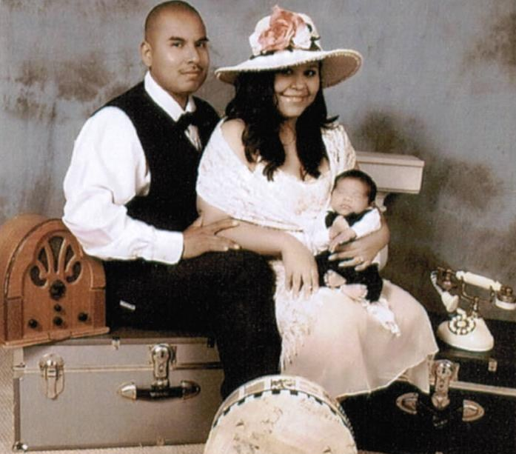
NaProTECHNOLOGY
In Demand

Slide 18
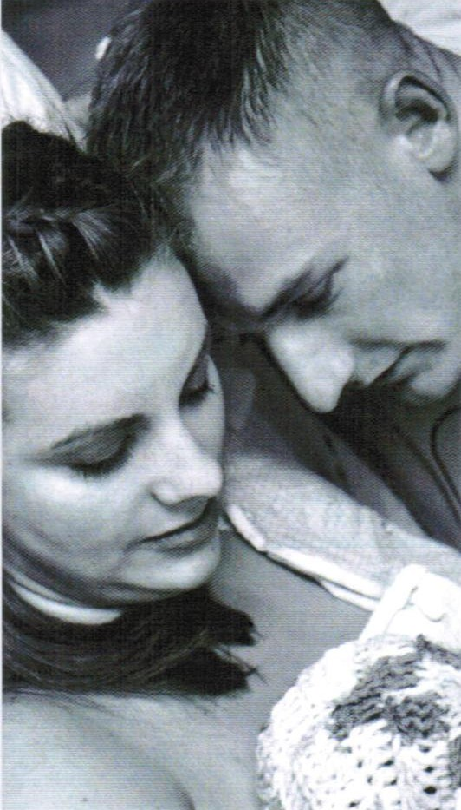
What Kind of Patients Are Seeking NaProTECHNOLOGY?
Catholic women/couples who want to remain faithful to the Church’s teachings on medical ethics
Catholic women/couples who have tried the unethical “standard of care” treatments and are unsatisfied
Non-Catholic Christian women/couples who are beginning to realize the deeper implications of what it means to be Pro-Life
Women/couples regardless of faith who have tried the “standard of care” treatments and are unsatisfied
Women/couples regardless of faith who want an approach that empowers them to understand and cooperate with their bodies

Slide 19
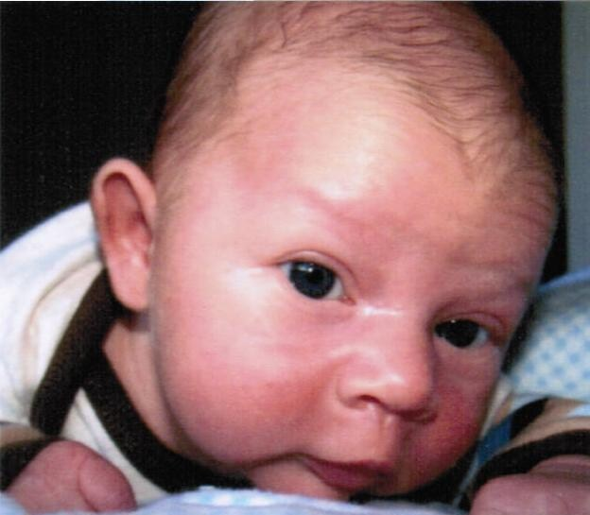
What Are Patients Saying About NaPro?
“Why haven’t we heard about NaPro before?”
“Why aren’t all physicians taught this in medical school?”
“Why wouldn’t all women want to be treated like this?”
“I wish we would have known about this before we…”
“I had to drive/fly a long way to get here.”
“Are there any doctors like you closer to where we live?”
“Can you move closer to where we live?”

Slide 20
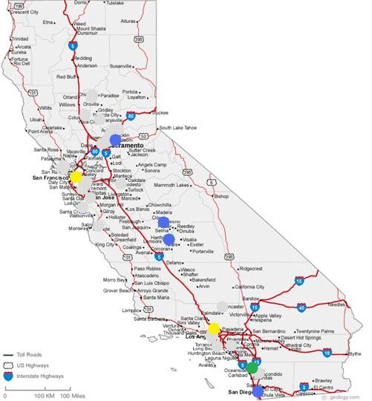
NaPro-Trained Physicians in California

Slide 21
Does Catholic Healthcare Need NaProTECHNOLOGY?
Oh Yeah!
Do Patients Want NaProTECHNOLOGY?
They like it, they love it, they want some more of it!

Slide 22

How is Catholic Healthcare Going to Get NaProTECHNOLOGY?

Slide 23
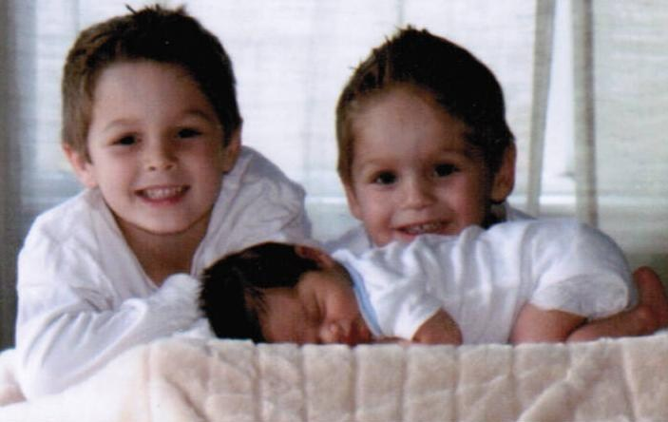
Multidisciplinary Approach
NaProTECHNOLOGY trained physician (preferably fellowship trained as well)
Creighton Model Practicioner(s)
Office Manager
Business & Marketing Manager
Legal Counselor
Technology Manager
Partnership with a hospital
Spiritual Guidance
Community Support
Ongoing Research & Development of NaPro Treatments
Continuing Education of NaPro Physicians

Slide 24

NaProTECHNOLOGY Medical Practice Startup & Management Company
A Catholic medical management company with an expertise in NaProTECHNOLOGY medical practices and a goal of expanding the availability of NaPro-trained physicians
  Help new grad NaPro-trained physicians set up a new practice
  Help established physicians switching to NaPro health services transition their current practice
  Offer consulting on best NaPro practices to existing NaPro medical practices
  Ongoing management of existing NaPro practices

Slide 25


Catholic Healthcare & NaProTECHNOLOGY
The Future Looks Bright

Slide 26



Lo, sons are a heritage from the Lord
Psalm 127:3

